Slide 1

Developed by-
Mohnish Jham (36)
Aamir Sabir (58)

Slide 2
What is Slogger?
Slogger - Service Logger, is a complete desktop/mobile based application designed for small businesses and service providers.
With the Digital India initiative every person has a smartphone in their pockets which they are already comfortable with. Our application just gives the users the ease of access to effortlessly carry out their daily tasks in a fraction of the time taken before.

Slide 3
Existing System...
We took on the streets to survey about the already existing system in place and 90% of the businesses are still using the old “Khaata book” based system which leads to heaps of space getting used for book storage and a tardy system.
Even the existing service management systems are quite complicated to use and expensive for a small businessman.
Our system aims to provide a user-friendly interface with low cost and maintenance due to its modularity.

Slide 4
Old Design and Interface...

Slide 5
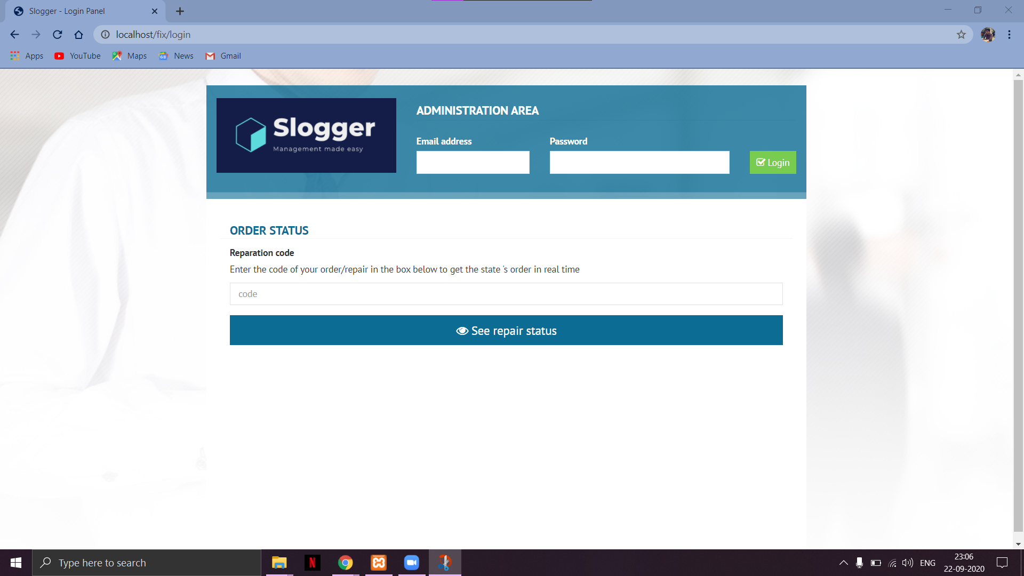
Login Page

Slide 6
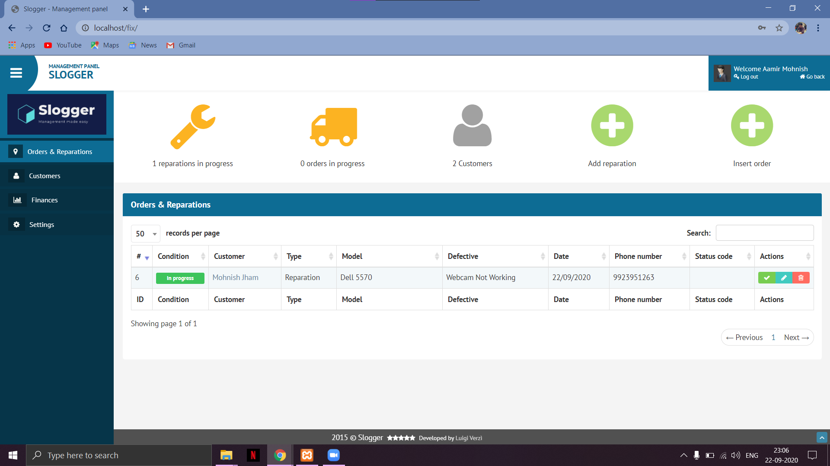
Homepage

Slide 7
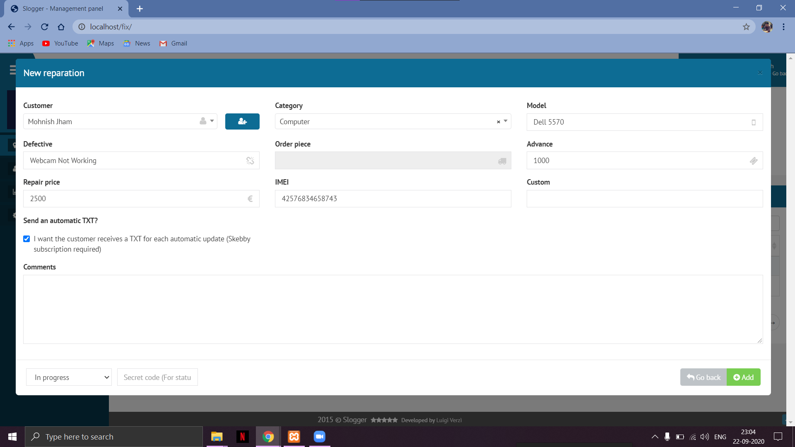
Add a new Record

Slide 8
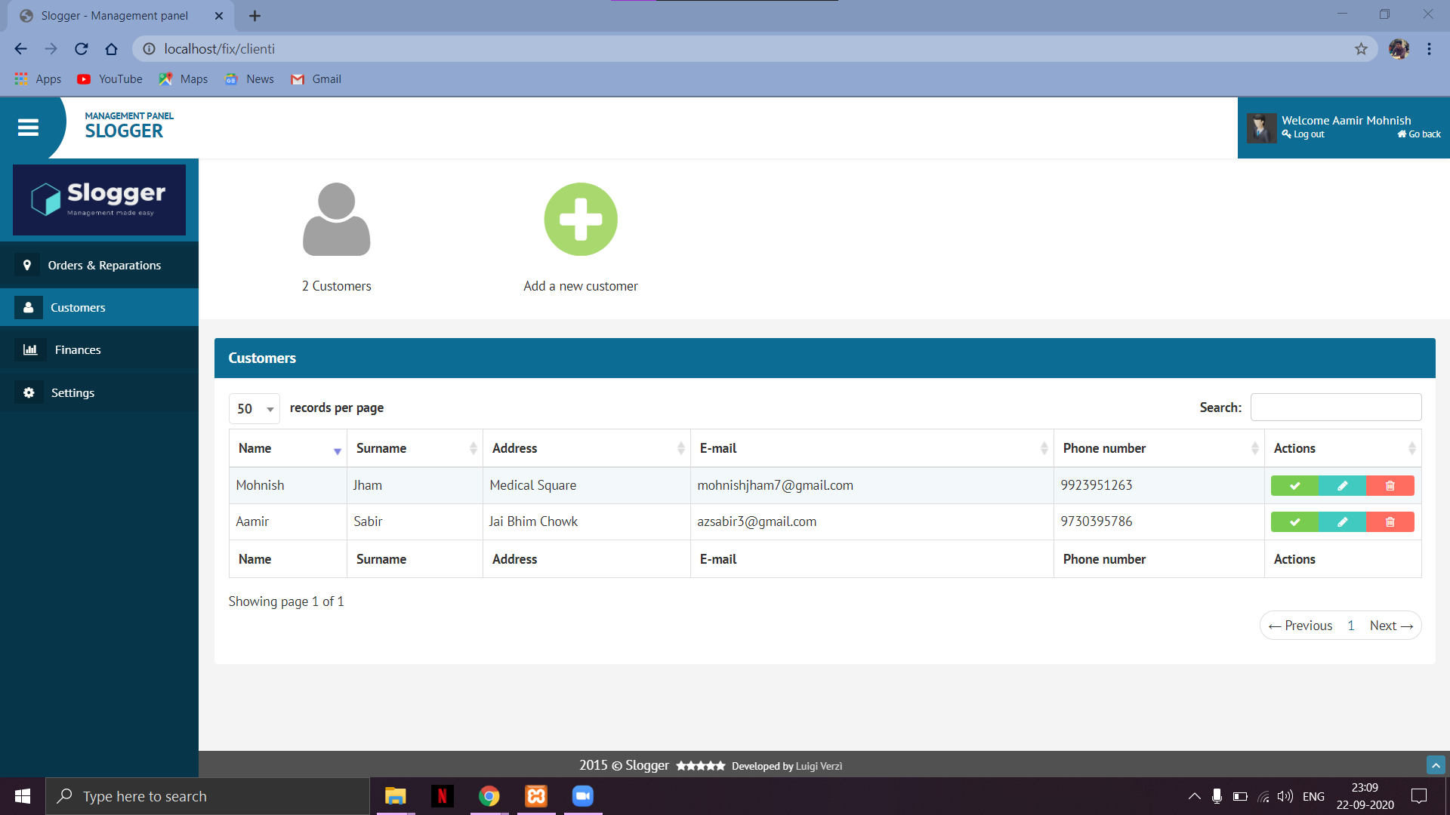
Customer Records

Slide 9
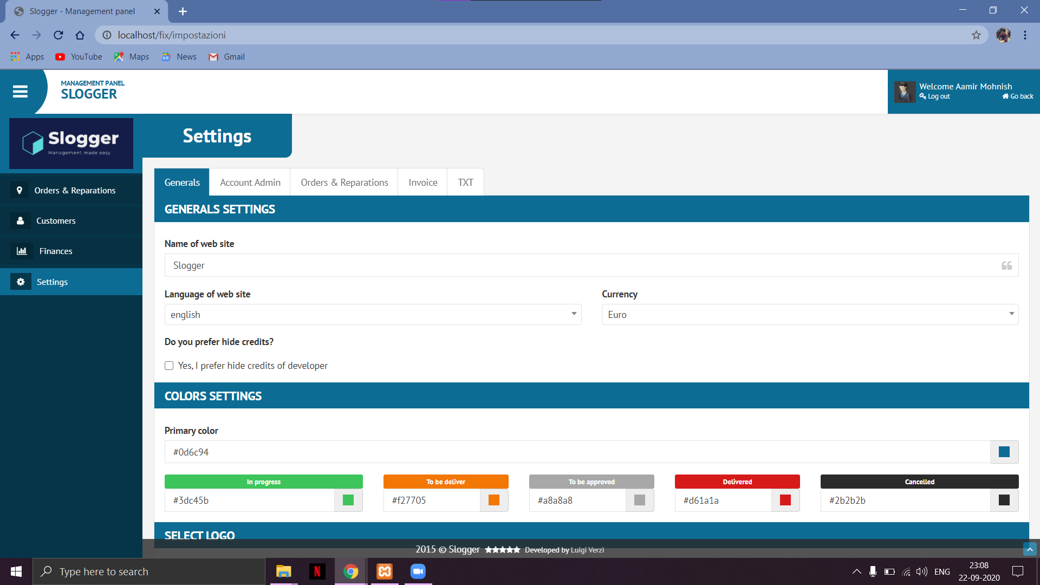
Settings

Slide 10
New Design and User Interface…

Slide 11
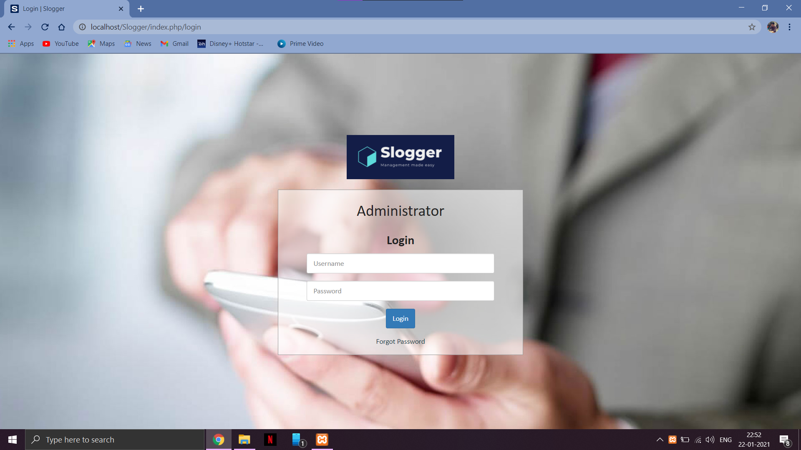
Login Page

Slide 12
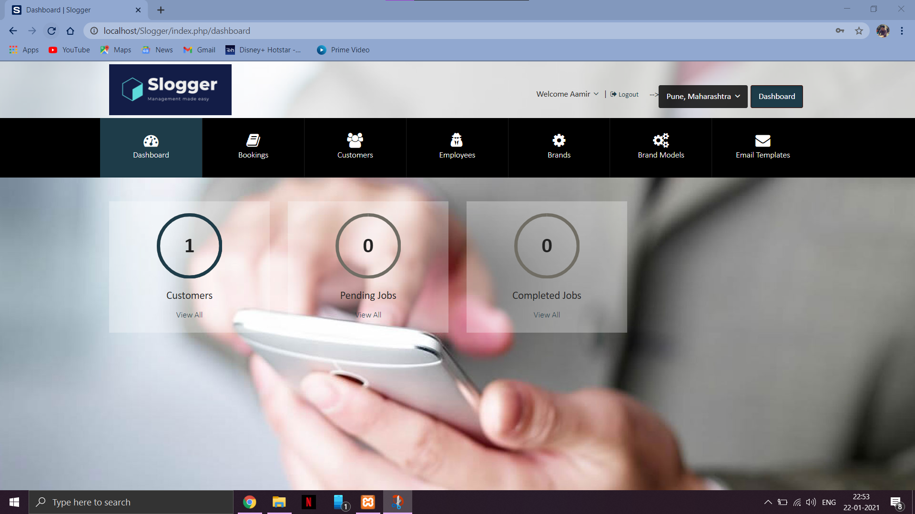
Dashboard

Slide 13
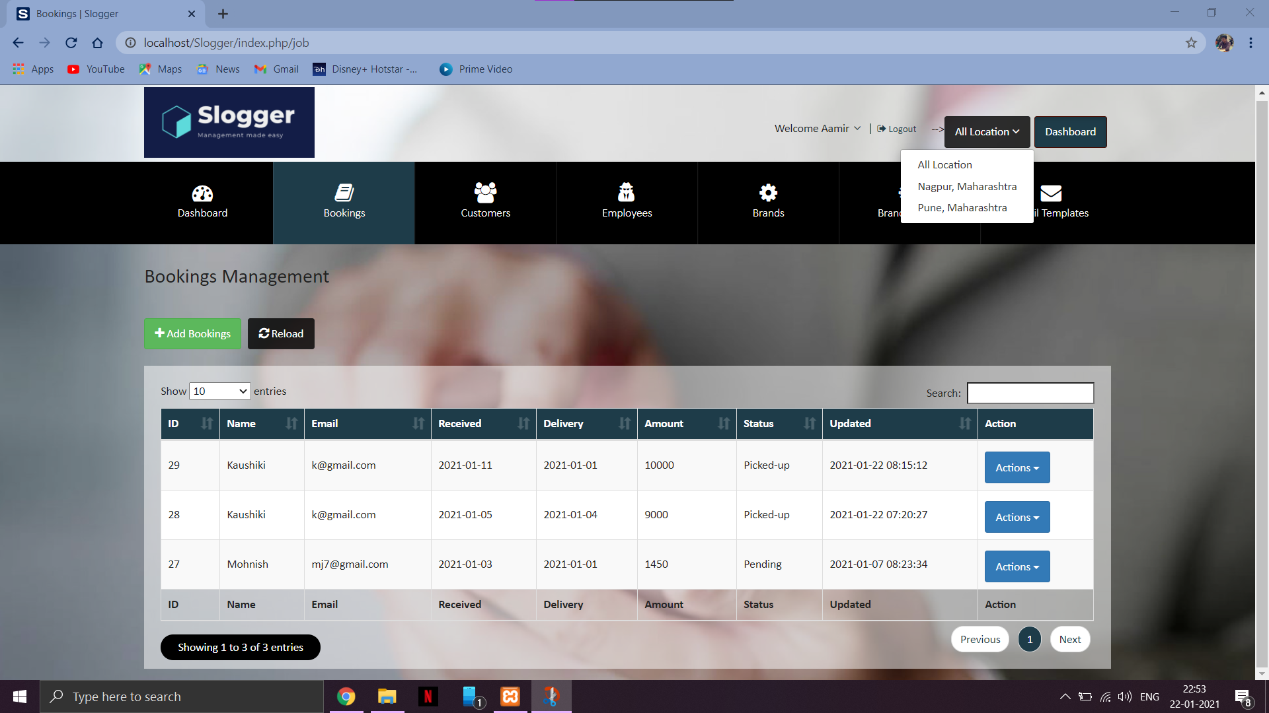
Bookings

Slide 14
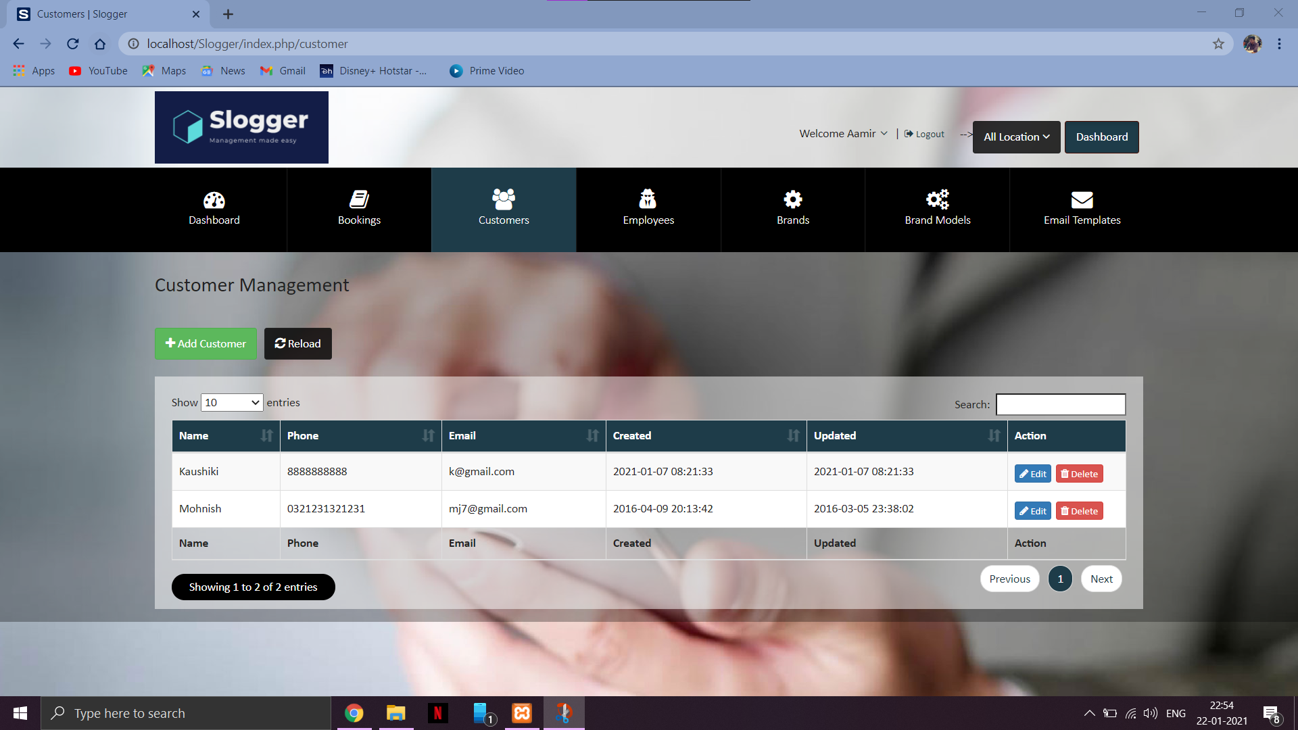
Customers

Slide 15
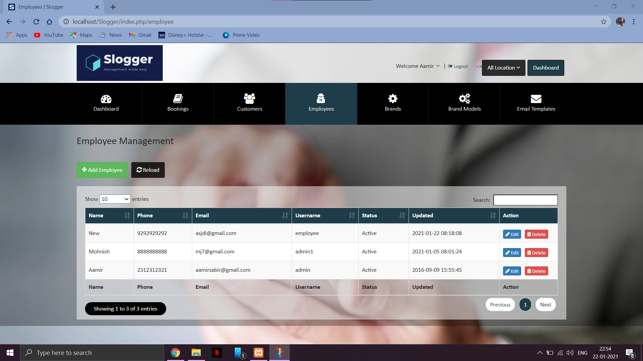
Employee

Slide 16
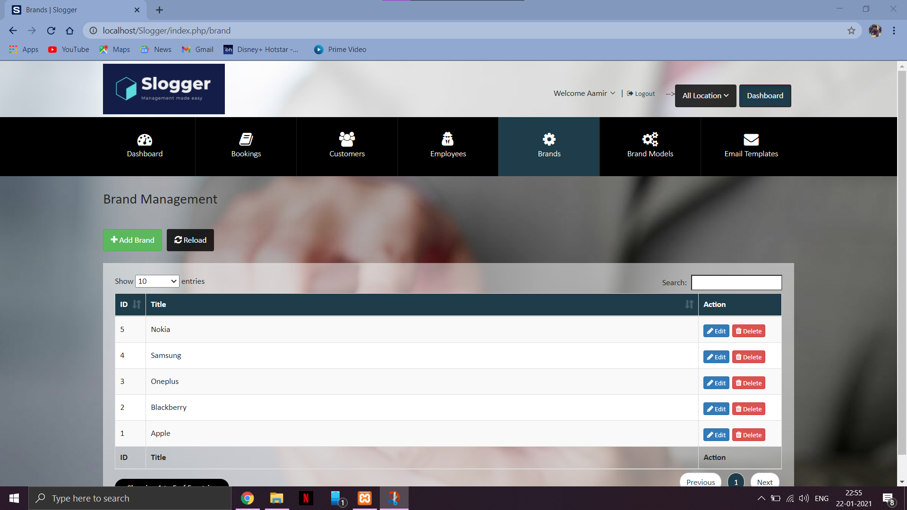
Brands Table

Slide 17
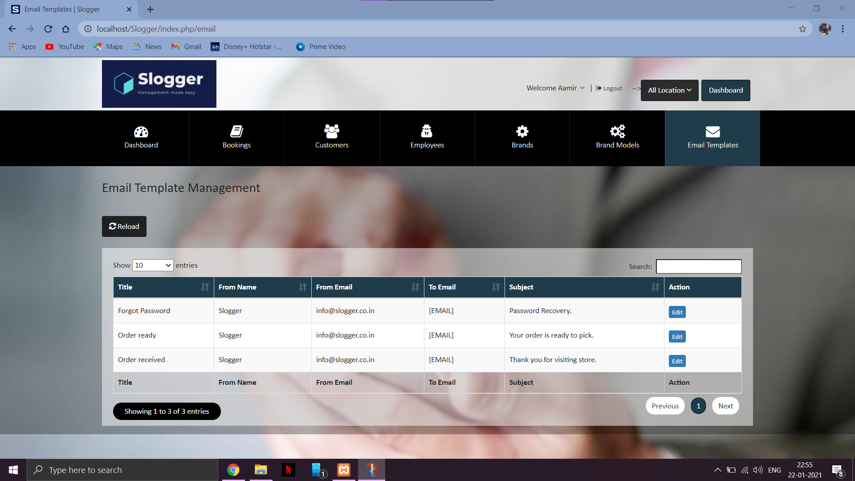
Automatic Email Templates

Slide 18
Diagrams... (Back End)

Slide 19
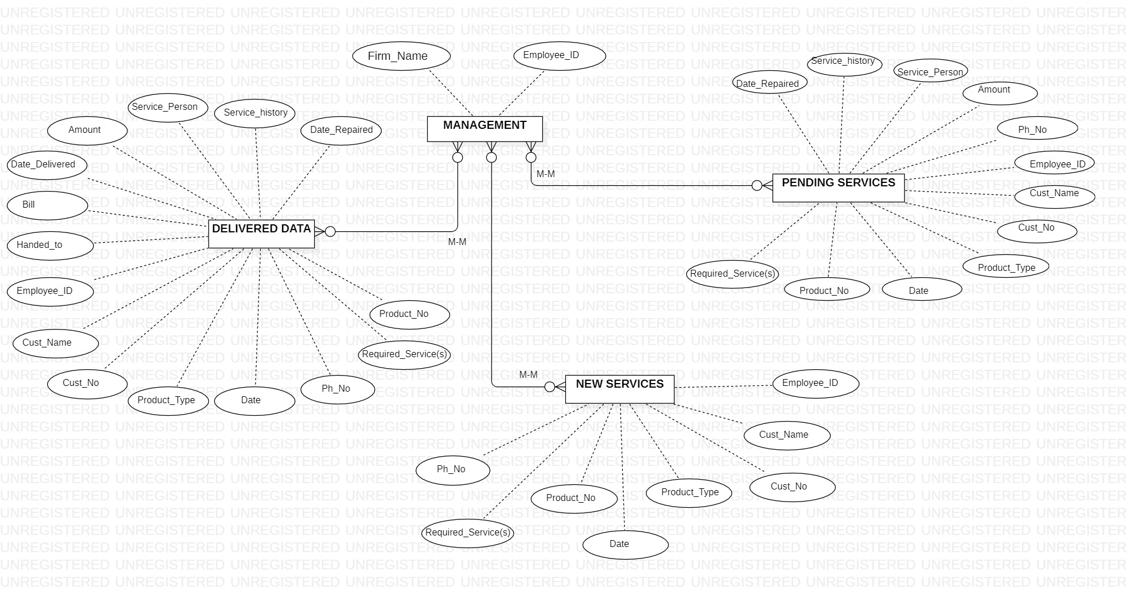
Entity-Relationship

Slide 20
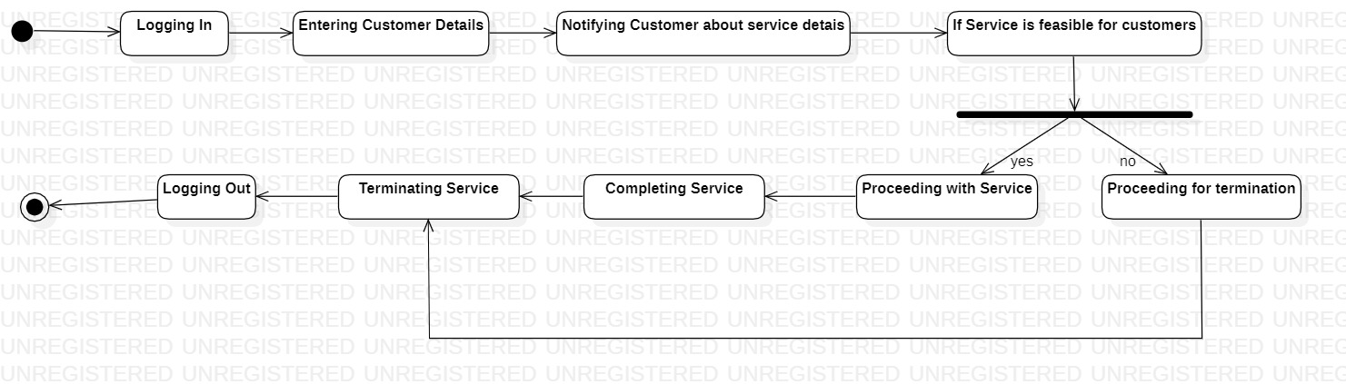
State-Chart

Slide 21
Conclusion...
Slogger is a simple desktop based application basically suitable for small organization. It has every basic items which are used for the small organization. Our team is successful in making the application where we can update, insert and delete the item as per the requirement.
Though it has some limitations, our team strongly believes that the implementation of this system will surely benefit the organization.

Slide 22
Thank You!

